Slide 1
Statistical Modeling – Part 2
Modern Statistics for Modern Biology

Slide 2
Goals
Difference between "Probability" and "statistics"
Fit data to probability distributions using → visualisation
Estimating procedures such as Maximum Likelihood
Statistical models and estimation to evaluate dependencies in binomial and multinomial distributions
Analyze some historically intersting genomic data assembled into tables
Make markov chain models for dependent data
Few concrete applications counting motifs in whole genomes and manipulate special Bioconductor classes dedicated to genomic data

Slide 3
Statistical vs probabilistic models
Probabilistic models:
no unknown parameters
→can calculate the expected probabilities
Statistical models:
Parameteres not give
Start from data to estimate probability model (poisson, normal, binoial) and its parameters
→ Estimates the expected probabilities

Slide 4
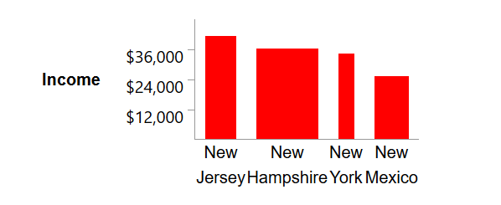
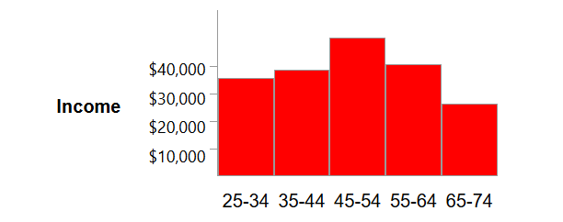
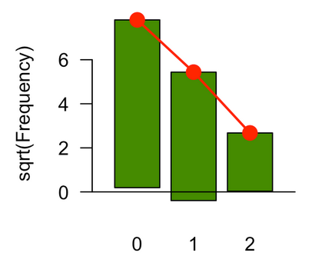
An example of statistical modeling
What distribution fits the data?
Barplot → each column represents a categrical variable
Histogram → each column represents a contiuous quanitative variable
Rootogram → it hangs the bars with the observed counts form the theoretical read points
Notes:
https://stattrek.com/statistics/charts/histogram.aspx

Slide 5
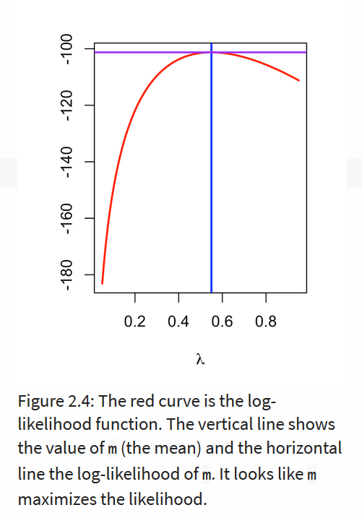
An example of statistical modeling
Goodness of fit
Maximum likelihood estimator (MLE) → idea: find the parameter that under the assumed statistical model make the observed data most probable
Notes:
https://stattrek.com/statistics/charts/histogram.aspx

Slide 6
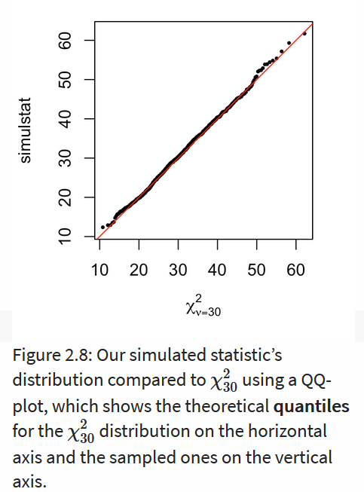
An example of statistical modeling
Goodness of fit
Maximum likelihood estimator (MLE) → idea: find the parameter that under the assumed statistical model make the observed data most probable
Quantilie-quantile plot (QQ-plot) → idea: compare two distributions (within same data or data and assumed distribution) by plotting the quantiles against each other
Notes:
https://stattrek.com/statistics/charts/histogram.aspx

Slide 7
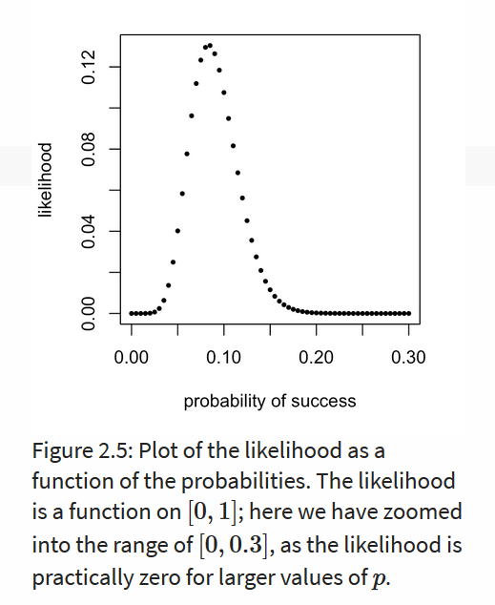
Likelihood vs probability
Same mathematical function
Different interpretation
Likelihood → data as part of the general distribution → how probable is the observed data given the parameters
Probability → data is fixed → we ask for the particular parameter value

Slide 8
What model to choose?
Binomial (n trials, p probability) → case/control studies, yes/no observatiosn
Multinomial (m outcomes, with p_{m} probabilities) → Distributions of the DNA bases in different genes
Chi-square → case/control and frequencies (checks if ther is statistical significant difference between the expected frequencies and the observed frequencies)

Slide 9
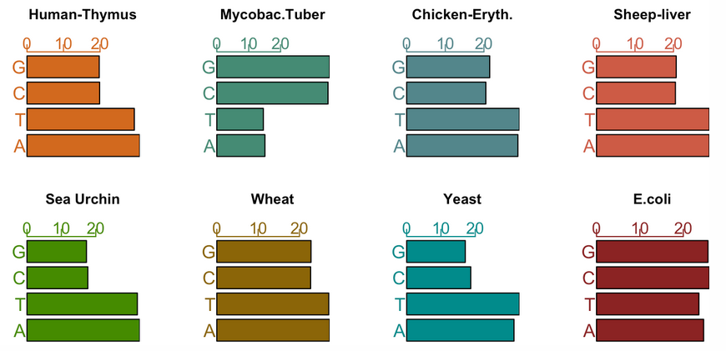


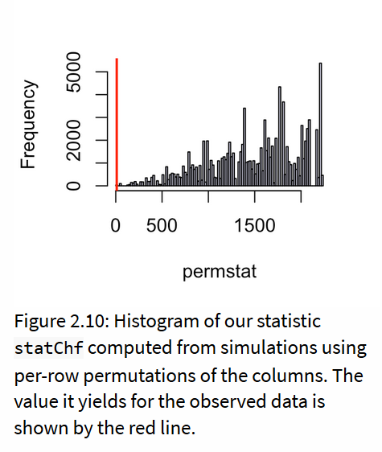
Chargaff's Rule
Pattern in nucleotide frequencies

Slide 10
Chargaff's Rule
Pattern in nucleotide frequencies
Why one-sided test?
→ It is a squared function based on prior knowledge it is only interesting if our value is smaller than the oter
Notes:
Comparison of if the nucleotides were or were not exchangeable

Slide 11
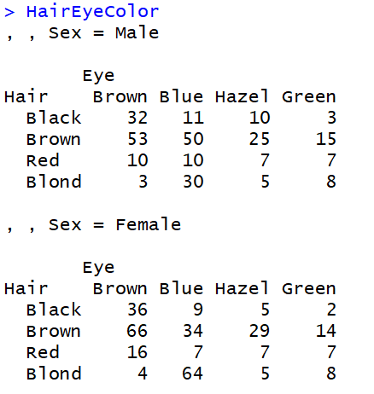
Two categorical variables
Contingency table: HairEyeColor
592 observations
3 Factors (hair, eye & sex) → 3 dimensions

Slide 12
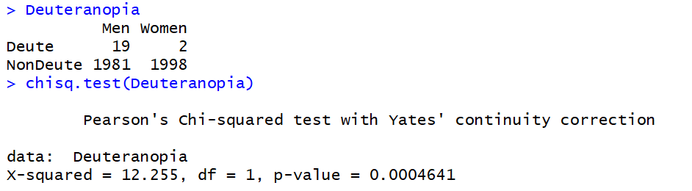
Two categorical variables
Color blindness and sex
H0: There is no relationship between color blindess and sex

Slide 13
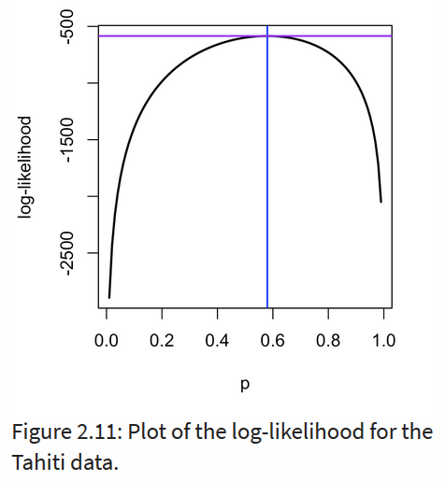


Hardy-Weinberg equilibrium
Multinomial with 3 levels from the combination of 2 alleles
M with frequency q
N with frequency p → q = 1-p
Probabilities of the three levels:
$$1=p^{2}+2pq+ q^{2}$$
Notes:
Based on the assumption of random mating in a population

Slide 14
Hardy-Weinberg equilibrium
Example in the book:
Only count data
Calculate all Likelihoods for the count data to be observed when p and q vary from 0.01 up to 0.99
Takes the maximum likelihood
Predict p and q based on the maximum likelihood
Calculate the expected count data based on the predicted allele frequencies
Compare the expected to the observed count data
Notes:
Based on the assumption of random mating in a population

Slide 15
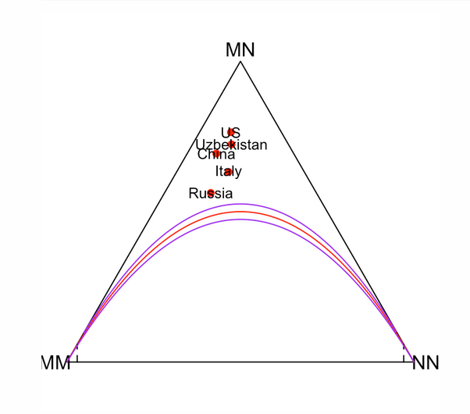
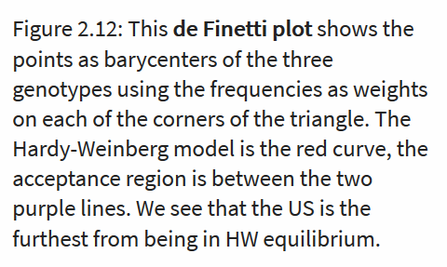
Hardy-Weinberg equilibrium
Notes:
Based on the assumption of random mating in a population

Slide 16
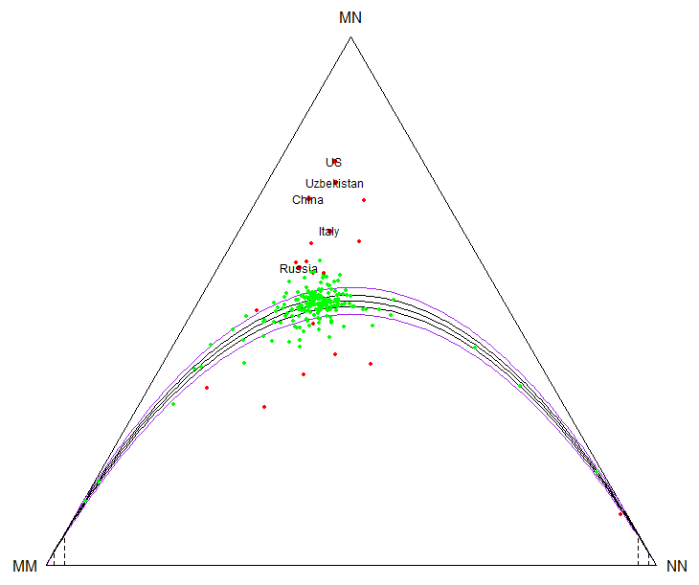
Hardy-Weinberg equilibrium
Notes:
Based on the assumption of random mating in a population

Slide 17
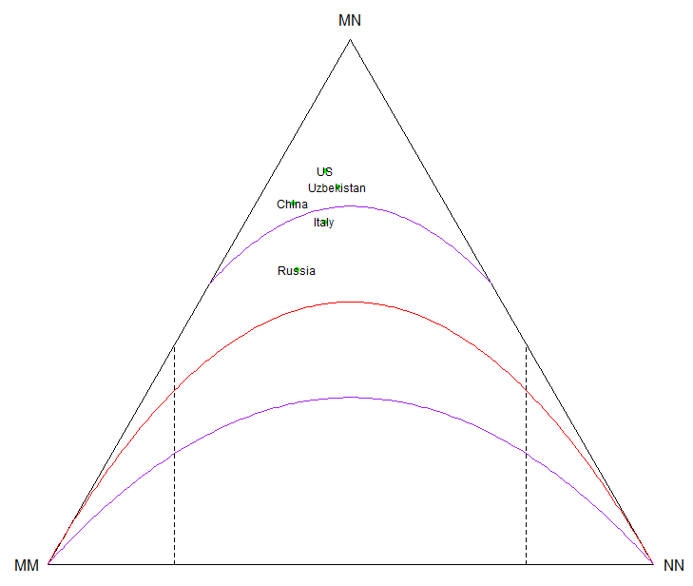
Hardy-Weinberg equilibrium
/50
Notes:
Confidence region becomes much larger

Slide 18




Inheritance of recessive lethal variants
X
Aa
Aa
Absence of
homozygosity
AA
Aa
aa
25%
50%
25%
Hardy-Weinberg equilibrium

Slide 19
Screening for missing homozygosity
Genome-wide scan for reduced or missing homozygosity
Datasets:
110k SNV array
Of 60'000 animals
Sliding window approach different window sizes (50-200 SNVs)

Slide 20
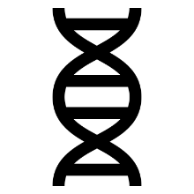

Sliding window approach
per autosome
chromosome

Slide 21
Sliding window approach
per autosome
chromosome
Software:
snp1101 (Sargolzei et al. 2014)
Notes:
$χ^{2} =\frac{{(O−E)}^{2}}{E}$
While X2 checks for the deviation beween the number of observed to the number of expected homozygous carrier
The exact test → checks the probability of observing a sample configuration that is even less likely than the one being evalueated, under the conditions of the observed allele counts

Slide 22

Haplotype screening
Significance test
$χ^{2}$-test:
$χ^{2} =\frac{{(O−E)}^{2}}{E}$
$E=n∗p^{2}$; with $n$ the number of genotyped animals used in the analysis
1 df and bonferroni correction
Hardy-Weinberg equilibrium $p^{2}+2pq+q^{2}=1$
Notes:
Significance test
-Calculated number of expected homozygote carrier
-Hardy-Weinberg equilibrium $p^{2}+2pq+q^{2}=1$ including the assumption of random mating
-$E=n∗p^{2}$; with n the number of genotyped animals used in the analysis
-$χ^{2}$-test: $χ^{2} =\frac{{(O−E)}^{2}}{E}$
-1 df and bonferroni correction
Validation
Selection of most significant haplotypes
Defining carrier status for animals → risk matings
Adding carrier status as additional fix effect in the routine breeding value estimation for different phenotypes
In the case of recessive lethals → No / few homozygots
Phenotypes: fertility: NRR, VZR, aborts
process of giving birth: distocia?, no help, little help, much help
upbrining losses: first month, up to one ear
growth: daily weight gain

Slide 23
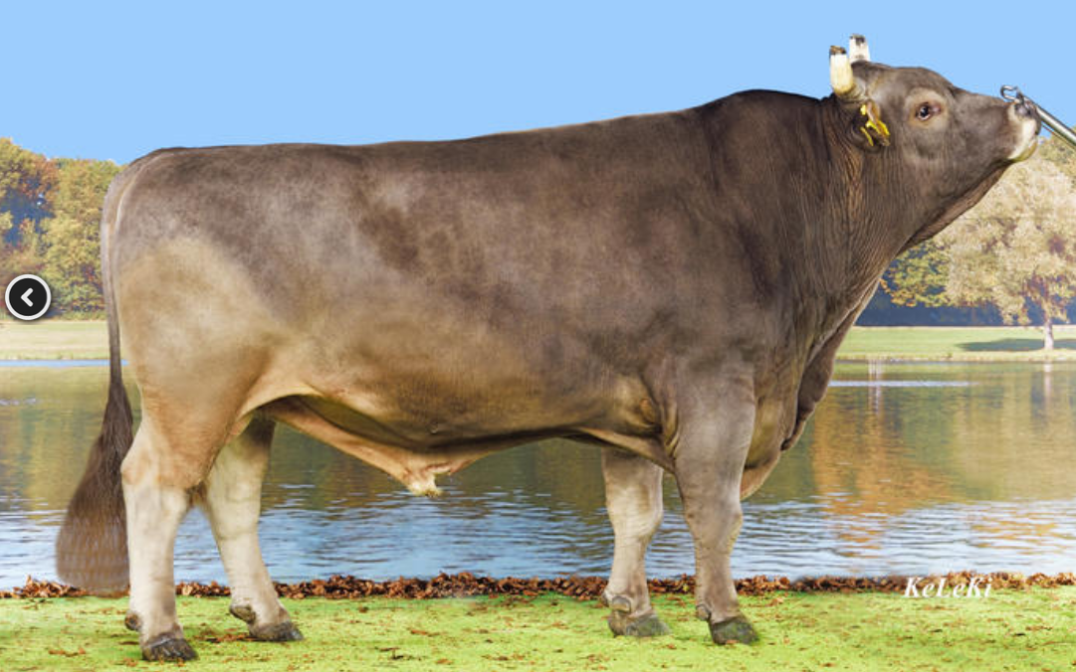
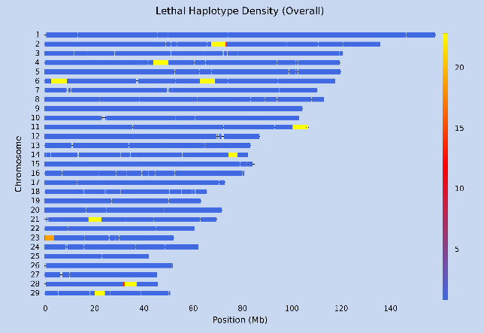
Original Braunvieh
regions of missing homozygosity
HD – window size 190 SNPs
Notes:
LD : 35'000 SNPs
HD : 115'000 SNPs
I will focus on chromosome 11

Slide 24
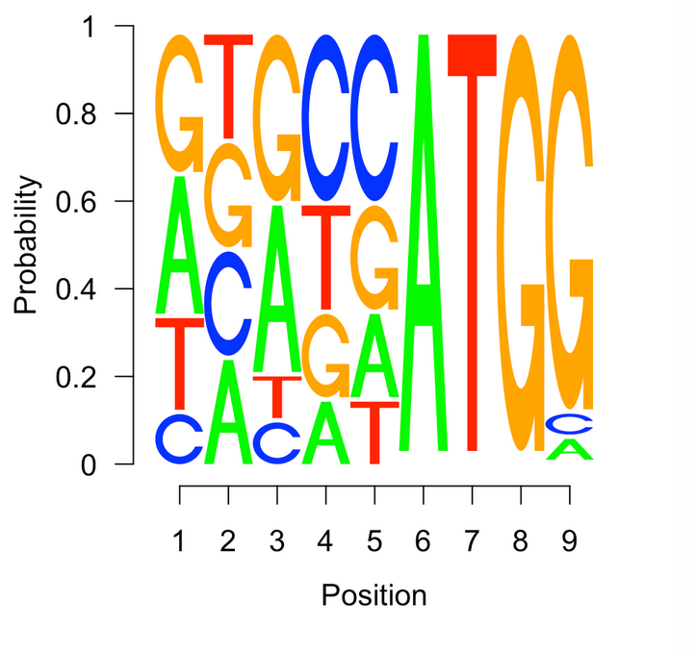
Concatenating several multinomials: sequence motifs and logos
Kozak motif: close to the start codon ATG
Depending on the position the nucleotide pattern is more or less fixed → Position weight matrix
Notes:
Could not download the package

Slide 25
Modeling sequential dependencies: Markov chains
Markov assumption: "The prediction for tomorrow depends only on the state of things today and not on yeserday or three weeks ago."
Essence: a process has a finite "memory"
Notes:
Weather example

Slide 26
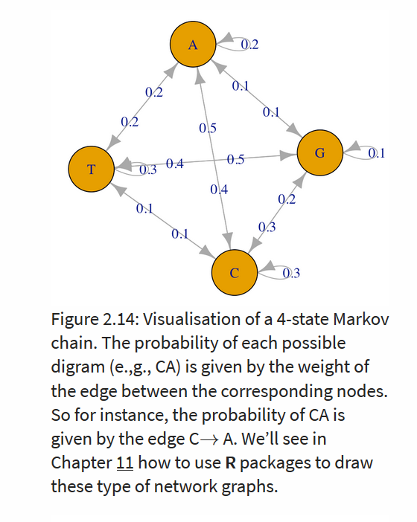
Markov chains – an example
Example: sequence of DANN
Pairs of nucleotides are not equally frequent
Notes:
Weather example

Slide 27


Markov chains – an example
Example: sequence of DANN
Pairs of nucleotides are not equally frequent
When assuming independence
Actual model needed
Notes:
Weather example

Slide 28
So far
Until now: fix probabilities over time
No prior knowledge that affects the estimation of probabilities

Slide 29
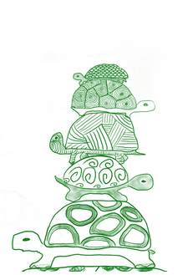
Bayesian thinking
Prior and posterior distributions are used as models of our knowledge before and after collecting data
Hierarchical models
Useful to combine information from different sources
Prior knowledge about H → P(H)
Posterior knowledge after seeing data D → P(H|D) "the probability of H given taht we sa D"

Slide 30
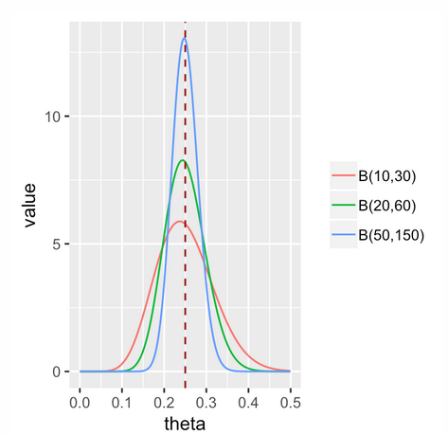
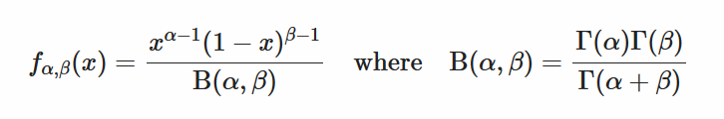
Bayesian thinking
Parameter ϴ is assumed to be drawn from a statistical distribution
Any distribution possible to use proportions or probabilities (distribution 0-1) → beta distribution
Distribution depends on α and β

Slide 31
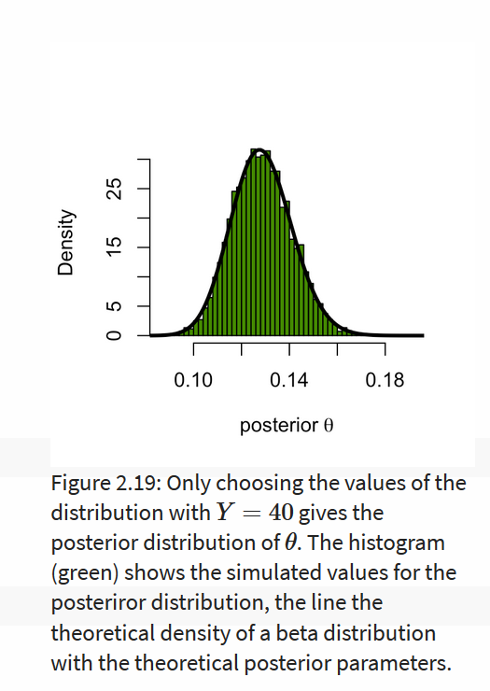
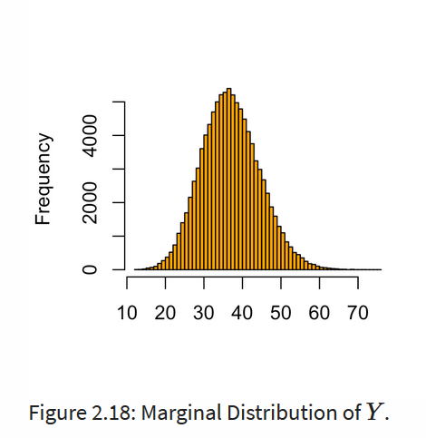
Simulation study of Y
Y=40;
N-Y=260
With a=60 and b=610
N=300
a=50 and b=350

Slide 32
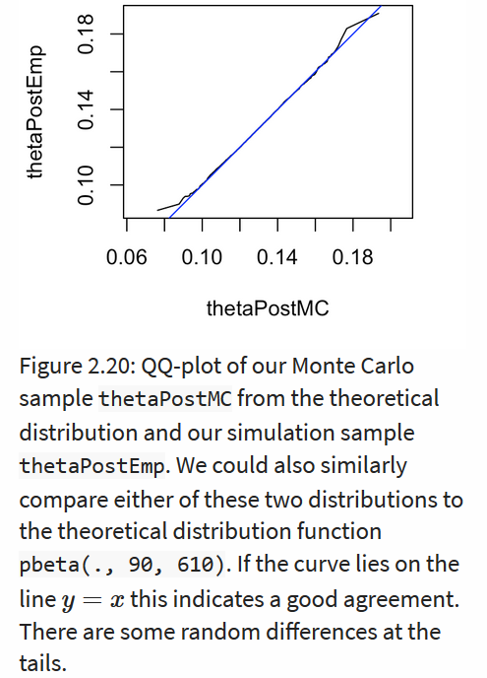

Simulation study of Y
Similar results with Monte Carlo simulation
Statistics can be updated with each new data set received → alpha and beta from the prior and n and y from the new data
Anaologous to CI: posterior credibility interval

Slide 33
Questions
Markov chains vs Bayesian thinking: Are they not the same?

